Slide 1

Resume Classification
Data Science Project-262 Group: 06
Mentor: Priyanka
2023-July
Team Members:
Ms.Krithi Pendem
Mr. Pushkar Manohar Chaudhari
Mr. Yash Vishnu Sarowar
Mr. Ramavat Sri Krishna
Mr. Aishwary Pradhan
Mr. DSN Raju
Mr. Ashish

Slide 2
Business Problem:
Resume Classification
Objective:
The document classification classification should significantly reduce the manual human effort in the Human Research Management. It should achieve a higher level of accuracy and automation with minimal human intervention.

Slide 3
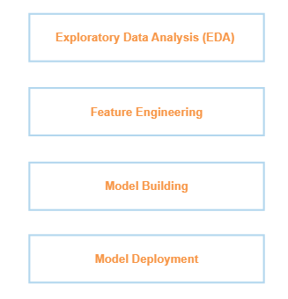
Project Architecture / Project Flow

Slide 4
Data Set Details
Types of Resumes Formats: docx, doc, pdf
Total Number of Resumes: 79
There are four types of resumes , and the corresponding number of resumes in each type are: 01. People Soft - 20 (Considered as data1)
02. React JS Developer - 24 (Considered as data 2)
03. SQL Developer - 14 (Considered as data 3)
04. Workday - 21 (Considered as data 4)
Resume data = combination of all the data from the resumes
Zero Null Values in the Data.
CSV Files:
Raw_Resume.csv
Cleaned_Resume.csv
Notes:
a

Slide 5
Exploratory Data Analysis (EDA)

Slide 6
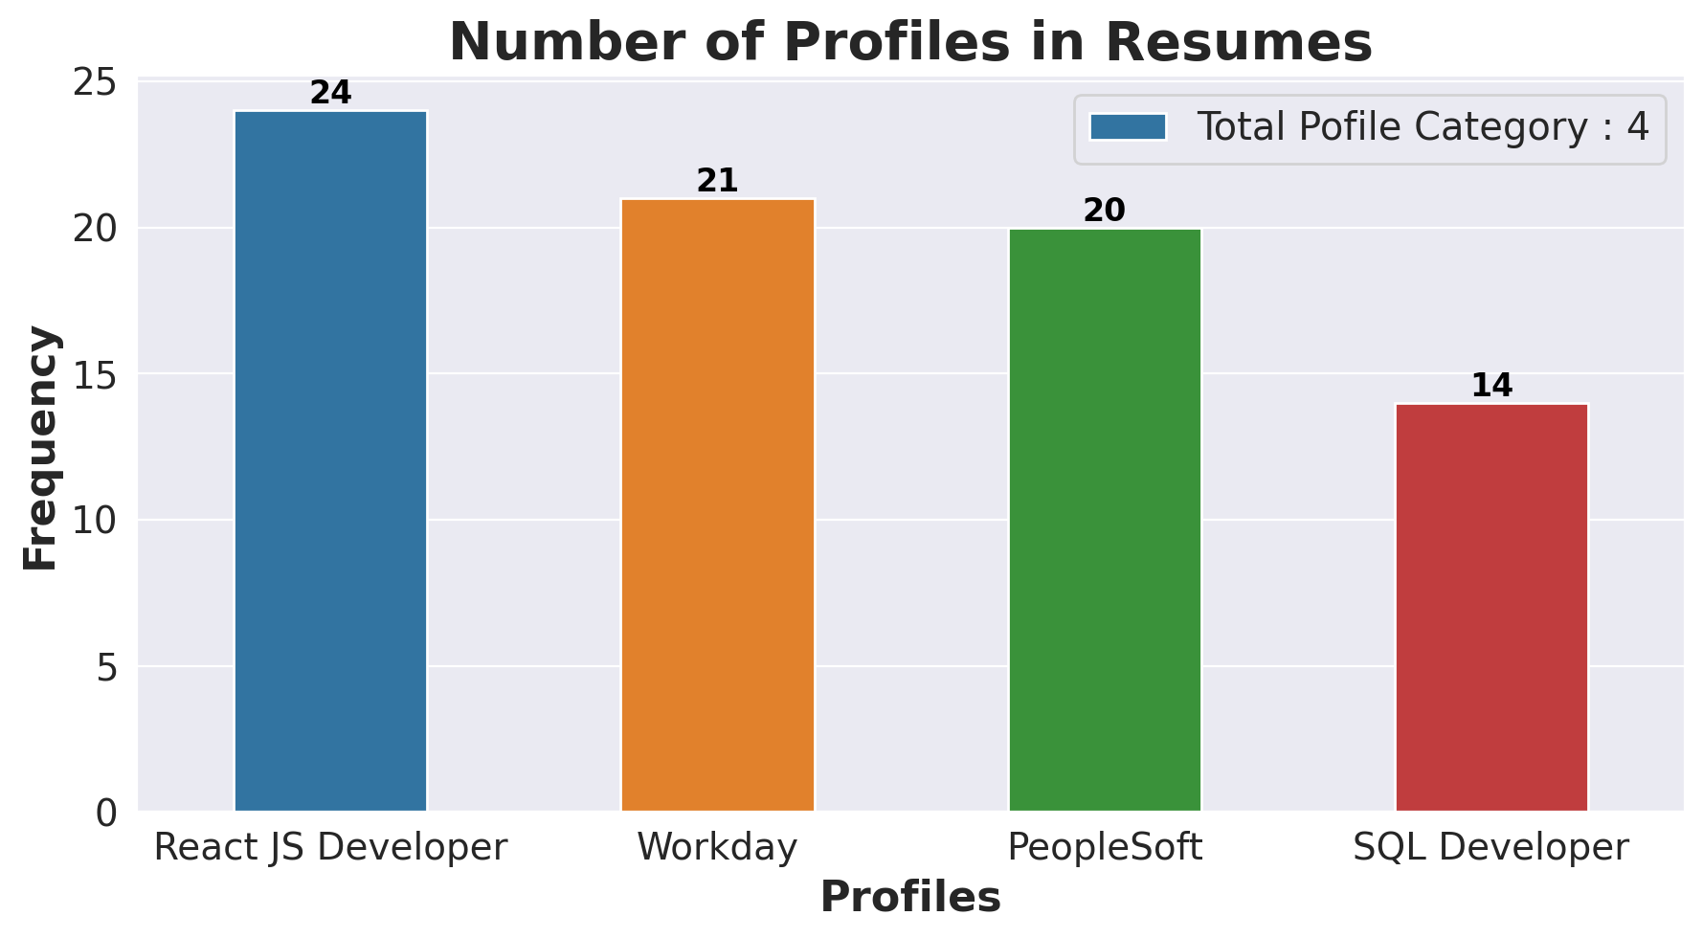
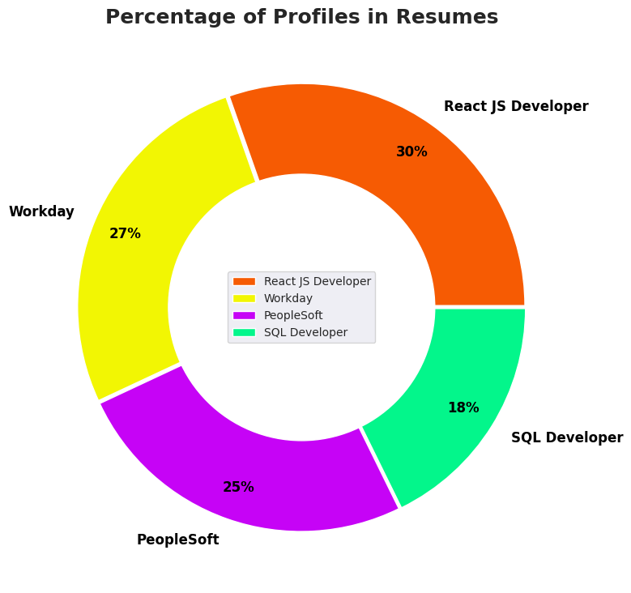
Exploratory Data Analysis (EDA)

Slide 7
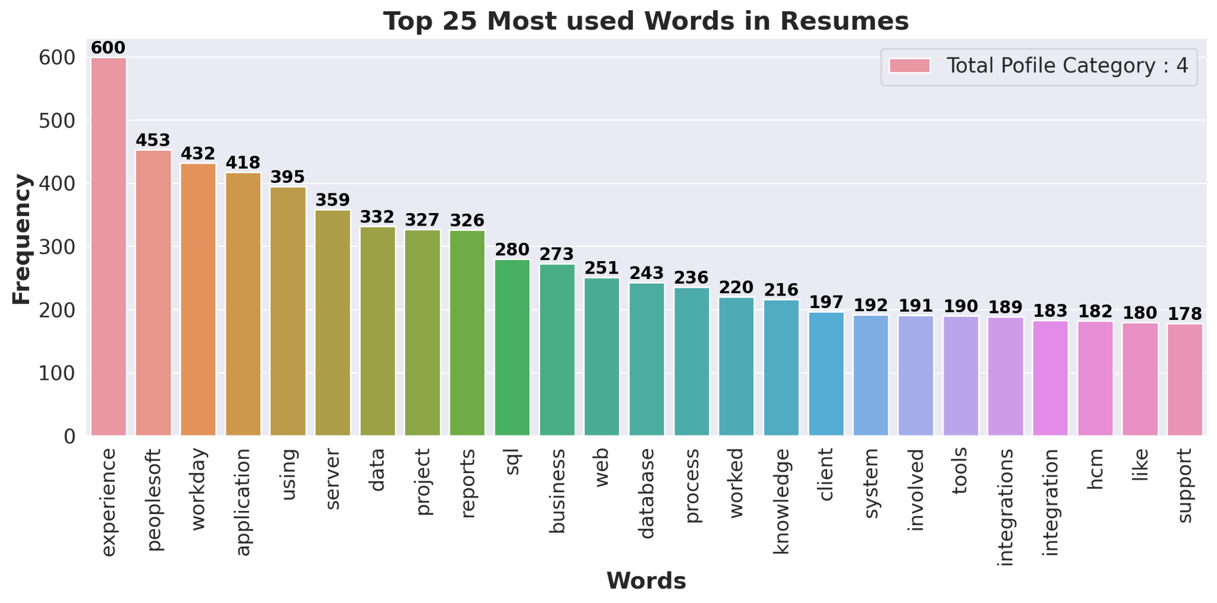
Exploratory Data Analysis (EDA)
In the top 25 most used nouns and verbs in resumes :
The top 05 words are: 01. Experience - 600
02. Peoplesoft - 453
03. Workday - 432
04. Application - 418
05. Using - 395

Slide 8
Model Building

Slide 9
Model Building
Pre Processing of Data using Label Encoder.
Model building using Train and Test Split (to evaluate your model's performance).
TF-IDF (Term Frequency-Inverse Document Frequency) :
Text data preprocessing and feature extraction in NLP tasks.
Represent textual data as numerical feature vectors that can be input to machine learning algorithms.
Classification Models:
1. KNN Classifier
2. DecisionTree Classifier
3. RandomForest Classifier
4. SVM Classifier
5. Logistic Regression
6. Bagging Classifier
7. AdaBoost Classifier
8. Gradient Boosting Classifier
9. Naive Bayes Classifier

Slide 10
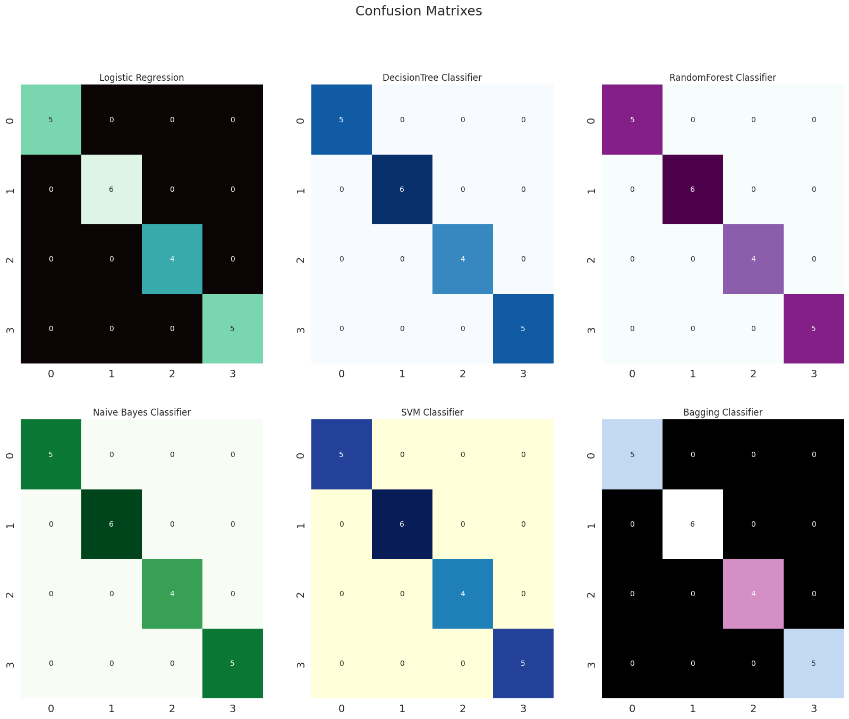
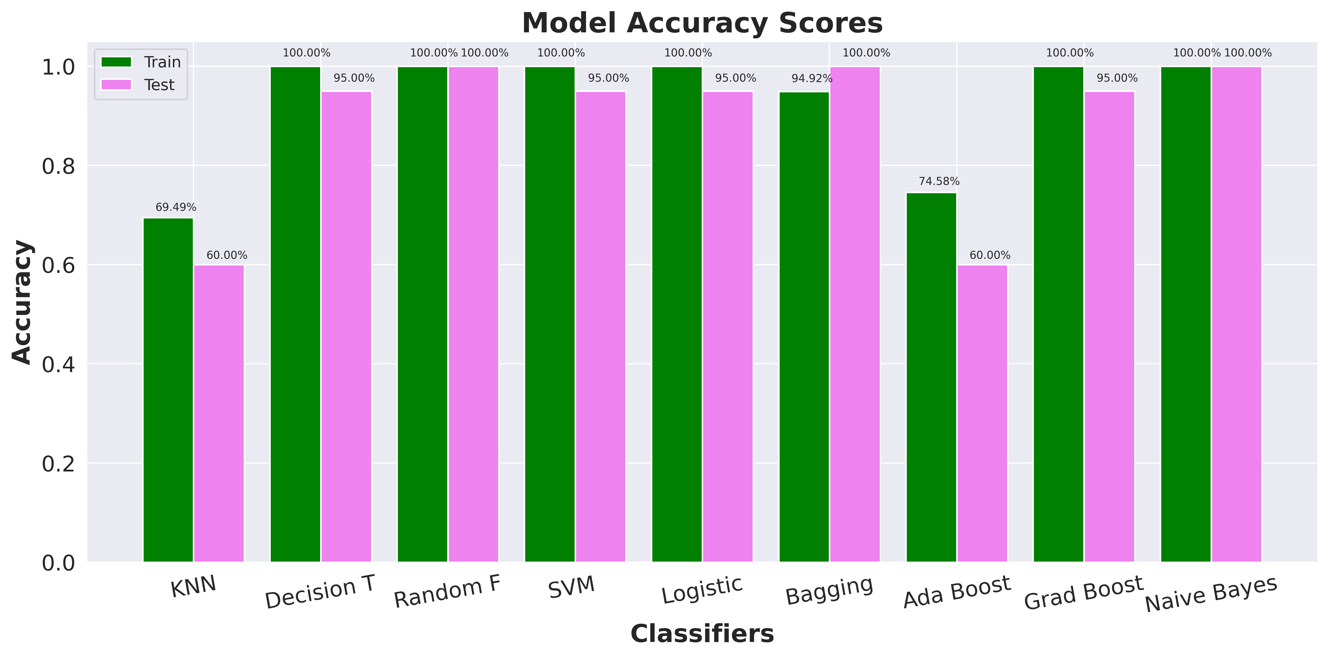
Model Building and Evaluation

Slide 11

Insights From the Model Building and Evaluation
The Various scores obtained from the model evaluation are:
 | Models | Train_ Accuracy(%) | Test_ Accuracy(%) | Precision(%) | Recall(%) | F1-Score(%)
0 | KNN Classifier | 0.694915 | 0.60 | 0.48 | 0.55 | 0.47
1 | DecisionTree Classifier | 1.000000 | 0.95 | 0.96 | 0.95 | 0.95
2 | RandomForest Classifier | 1.000000 | 1.00 | 1.00 | 1.00 | 1.00
3 | SVM Classifier | 1.000000 | 0.95 | 0.96 | 0.94 | 0.95
4 | Logistic Regression | 1.000000 | 0.95 | 0.96 | 0.94 | 0.95
5 | Bagging Classifier | 0.949153 | 1.00 | 1.00 | 1.00 | 1.00
6 | AdaBoost Classifier | 0.745763 | 0.60 | 0.62 | 0.57 | 0.55
7 | Gradient Boosting Classifier | 1.000000 | 0.95 | 0.96 | 0.94 | 0.95
8 | Naive Bayes Classifier | 1.000000 | 1.00 | 1.00 | 1.00 | 1.00

Slide 12
Model Deployment using streamlit library
using Platform- Spyder

Slide 13
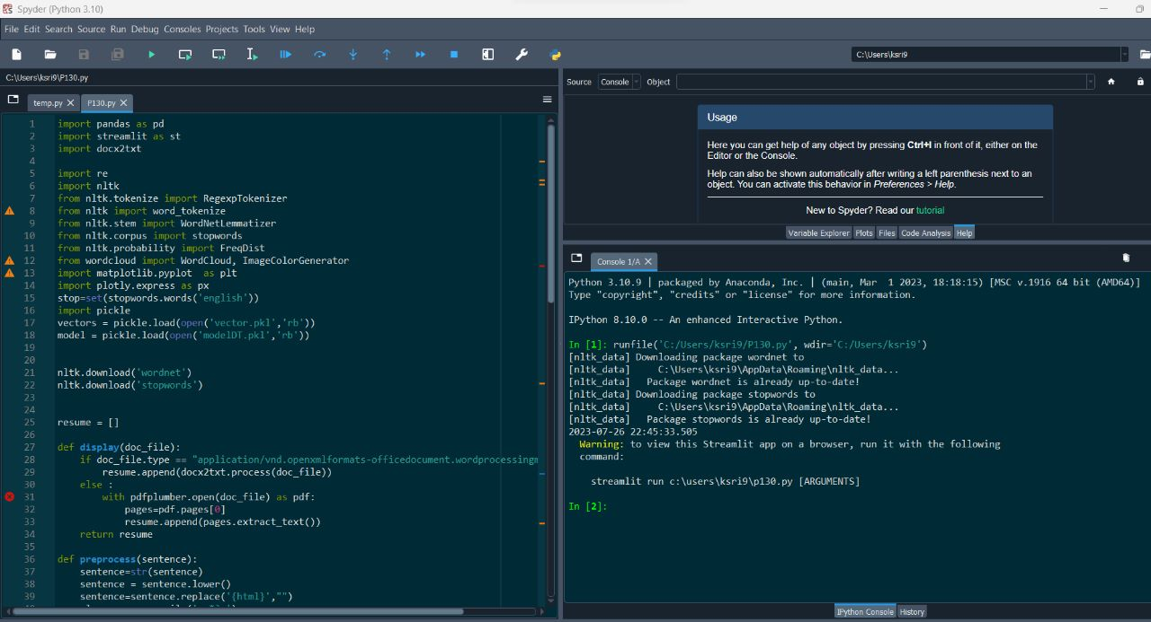
Code P130.py

Slide 14
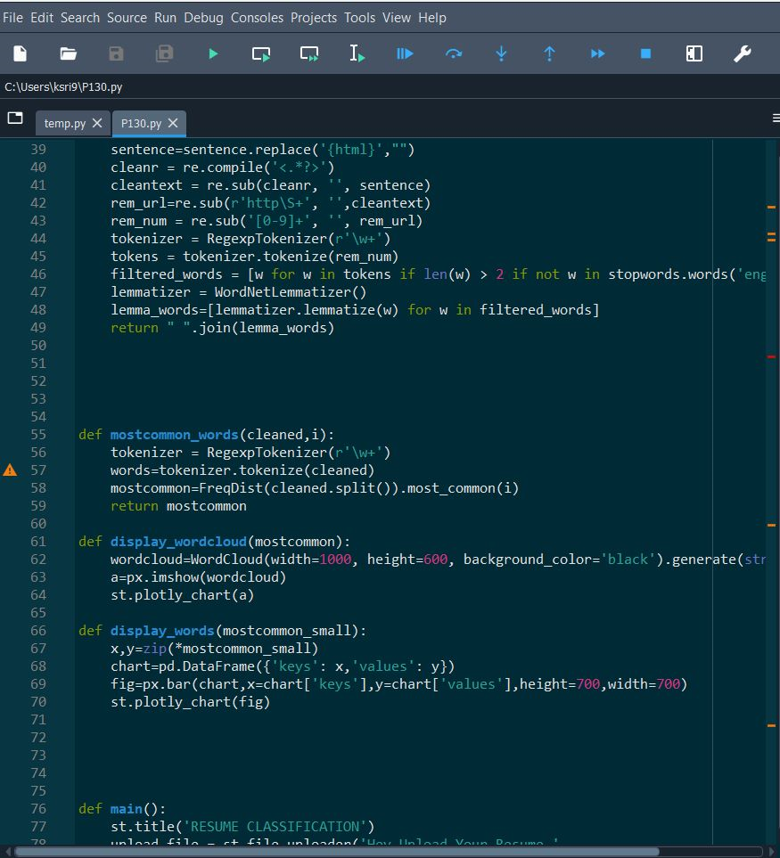
Code P130.py

Slide 15
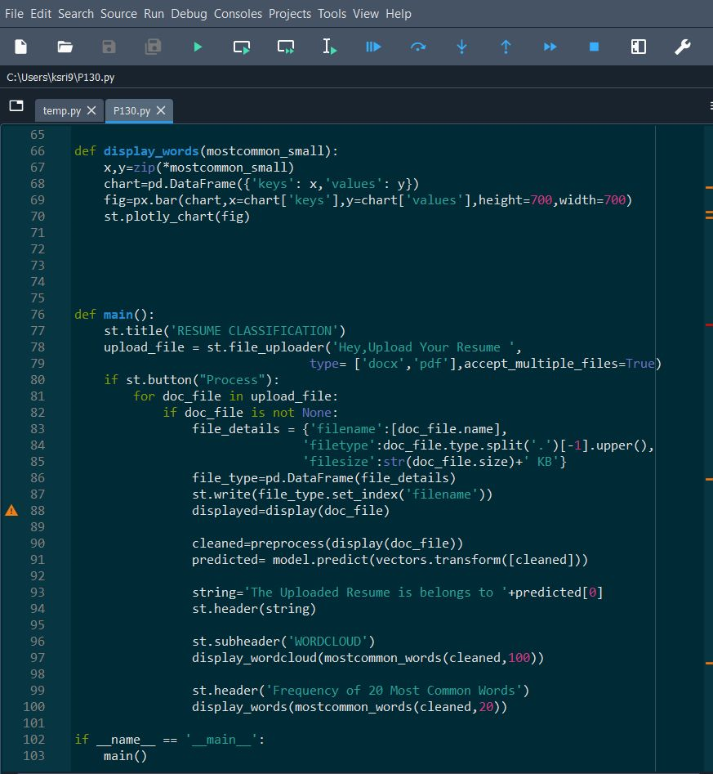
Code P130.py

Slide 16
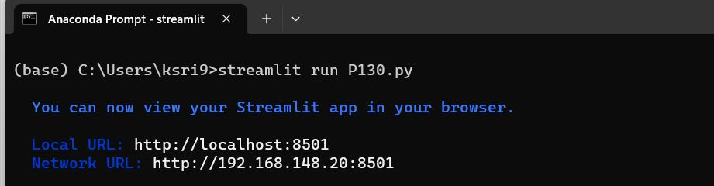
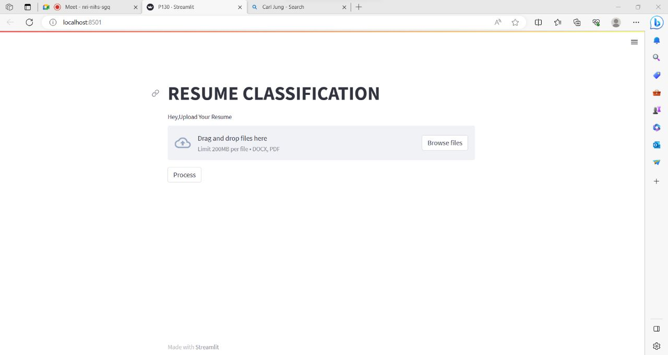
streamlit run P130.py

Slide 17
streamlit run P130.py
Streamlit WebPage

Slide 18
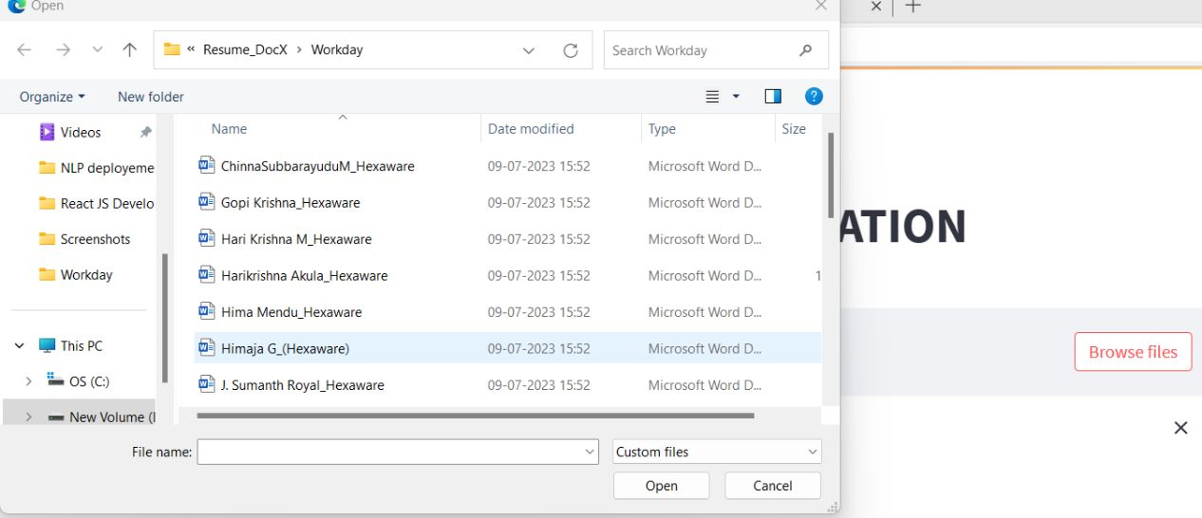
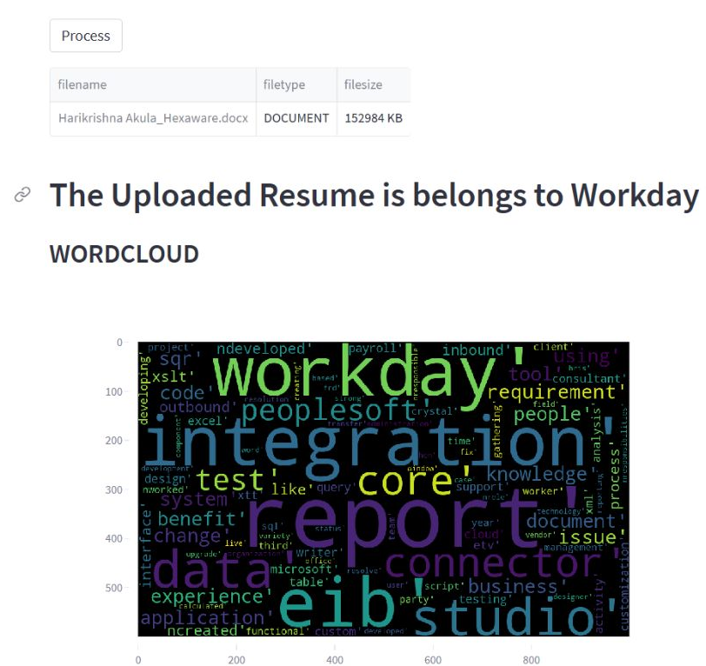
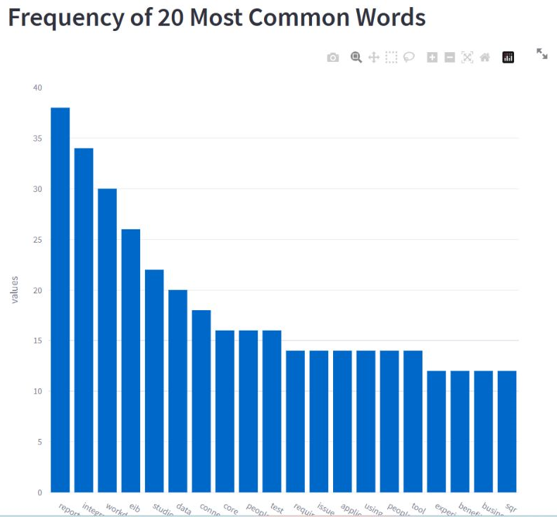
Streamlit WebPage

Slide 19
Files for the Project
Group 6_P-262_ Resume Classification Final.ppt file
28_07_2023_NLP_Resume_Classification_Full_Code___DS_P_262.ipynb file
modelDT.pkl file
vector.pkl file
P130.py (Deployment code)
Cleaned_Resumes.csv
Raw_Resume.csv
Resume_DocX Folder
Project Presentation Video

Slide 20
Thank you

